Slide 1
CONTENTS
Possible problems with the use of pointers
Dangling Pointer
Wild Pointer
Null Pointer

Slide 2
Possible problems with the use of pointers
Uninitialized Pointers: Pointer Un-initialization results in a runtime error.
The pointer may cause a memory leak: Memory leakage occurs in C++ when programmers allocates memory by using new keyword and forgets to deallocate the memory by using delete() function or delete[] operator. One of the most memory leakage occurs in C++ by using wrong delete operator
Dangling Pointers: If two pointers point to the same memory location and pointer 1 deallocates the memory but pointer 2 trying to access the memory thinking it is available is called dangling pointer.

Slide 3
Pointer Un-initialization
if we have declared a pointer then we should not use that pointer unless we have initialized it.
#include<iostream>
using namespace std;
int main() {
int *ptr;
cout<<*ptr;
return 0;
}

Slide 4
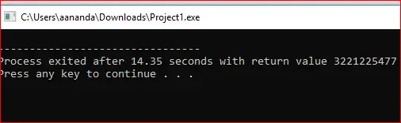
Output

Slide 5
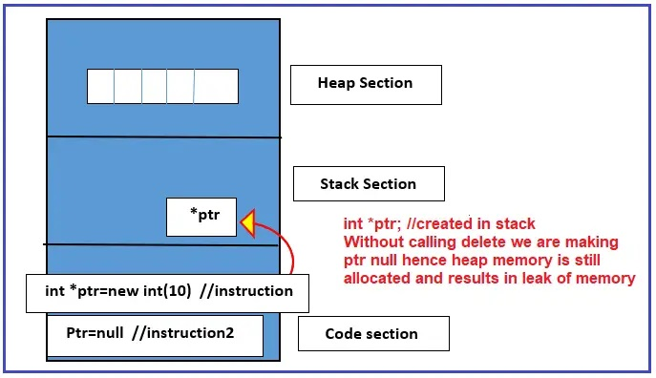
Memory leak

Slide 6
Dangling Pointer
Dangling pointers arise when an object is
deleted or de allocated, without modifying the
value of the pointer, so that the pointer still
points to the memory location of the de
allocated memory.

Slide 7
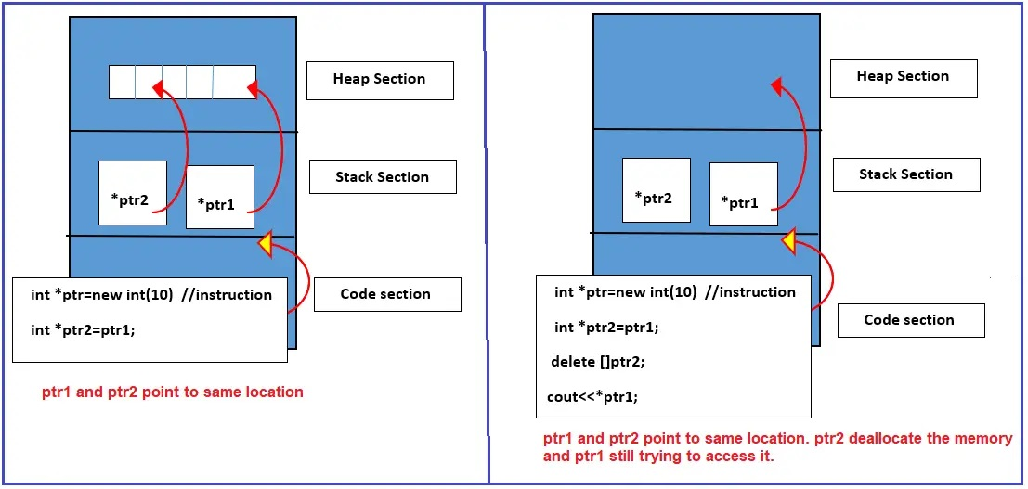
Dangling pointer

Slide 8
Example
// Deallocating a memory pointed by ptr causes
// dangling pointer
#include <cstdlib>
#include <iostream>
int main()
{
int* ptr = (int *)malloc(sizeof(int));
// After below free call, ptr becomes a
// dangling pointer
free(ptr);
// No more dangling pointer
ptr = NULL;
}

Slide 9
MCQ
1.Which of the following scenarios can lead to a dangling pointer?
a) Allocating memory using new and properly deallocating it using delete
b) Using the address of a local variable after the function that declared the variable has returned
c) Initializing a pointer with a valid memory address
d) Dereferencing a pointer immediately after allocating memory using malloc

Slide 10
1.Which of the following scenarios can lead to a dangling pointer?
a) Allocating memory using new and properly deallocating it using delete
b) Using the address of a local variable after the function that declared the variable has returned
c) Initializing a pointer with a valid memory address
d) Dereferencing a pointer immediately after allocating memory using malloc

Slide 11
2.How can you prevent dangling pointer issues in C/C++?
a) Always use smart pointers to manage memory
b) Avoid using pointers altogether
c) Always set pointers to nullptr after deallocating memory
d) Never deallocate memory explicitly

Slide 12
2.How can you prevent dangling pointer issues in C/C++?
a) Always use smart pointers to manage memory
b) Avoid using pointers altogether
c) Always set pointers to nullptr after deallocating memory
d) Never deallocate memory explicitly

Slide 13
3.Which tool is commonly used to detect and prevent dangling pointer issues in C/C++ programs?
a) Code linter
b) Compiler flag
c) Debugger
d) Memory profiler

Slide 14
Wild Pointer
Any uninitialized pointer is known as a wild pointer in C because it points to some arbitrary memory location and can cause a program to crash or behave unexpectedly.
A wild pointer in C is declared but not initialized. That is why, it points to any random memory location.
The wild pointer generates garbage memory location.

Slide 15
Example
#include<iostream>
using namespace std;
int main()
{
int *ptr; /* Ptr is a wild pointer in C */
/* Random unknown memory location is being allocated. This should never be done. */
*ptr=12;
cout<<"value of ptr"<<ptr;
}
Output
It display nothing or give some garbage value

Slide 16
Wild Pointer continues
A wild pointer in C language can lead to the following failures in our program:
Wild pointers can lead our program to crash during runtime.
Wild pointers can make our program behave unexpectedly because it may point to any unknown memory.
Wild pointers may point to a data value which has been deallocated. This may cause a runtime error in the code.

Slide 17
How to Avoid Wild Pointer in C?
To make our program error-free we must avoid wild pointers in our program. Avoiding wild pointers makes sure that our program will not cause any runtime or memory errors.
We can easily avoid the wild pointer in our program. To avoid this, we must initialize our pointer with some valid memory address at the time of declaration. We can initialize our pointer with the following things:
A variable
We can initialize our pointer with a valid variable’s address while declaring to prevent the wild pointer in C.

Slide 18
Example
#include<iostream>
using namespace std;
int main()
{
int *ptr; /* Ptr is a wild pointer in C */
/* Random unknown memory location is being allocated. This should never be done. */
int a=23;
ptr=&a;//ptr now no longer wild pointer
*ptr=12;//modified the value of a
cout<<"value of ptr"<<*ptr;
} OUTPUT: value of ptr12

Slide 19
MCQ
1.In which section of memory do wild pointers typically point?
a) Stack
b) Heap
c) Data
d) BSS (Block Started by Symbol)

Slide 20
MCQ
1.In which section of memory do wild pointers typically point?
a) Stack
b) Heap
c) Data
d) BSS (Block Started by Symbol)

Slide 21
2.What is the purpose of using wild pointers intentionally?
a) To demonstrate advanced pointer manipulation techniques
b) To create memory leaks deliberately
c) There is no legitimate purpose for using wild pointers intentionally
d) To increase program performance

Slide 22
2.What is the purpose of using wild pointers intentionally?
a) To demonstrate advanced pointer manipulation techniques
b) To create memory leaks deliberately
c) There is no legitimate purpose for using wild pointers intentionally
d) To increase program performance

Slide 23
3.Which of the following is NOT a common way to create a wild pointer?
a) Not initializing a pointer before use
b) Setting a pointer to null ptr explicitly
c) Forgetting to allocate memory using malloc() or new
d) Incorrectly using pointers after they have been deallocated

Slide 24
3.Which of the following is NOT a common way to create a wild pointer?
a) Not initializing a pointer before use
b) Setting a pointer to null ptr explicitly
c) Forgetting to allocate memory using malloc() or new
d) Incorrectly using pointers after they have been deallocated

Slide 25
NULL POINTER
A null pointer is a regular pointer of any pointer type which has a special value that indicates that it is not pointing to any valid reference or memory address. This value is the result of type-casting the integer value zero to any pointer type.
int * p;
p = 0; // p has a null pointer value

Slide 26
MCQ
1.What is the significance of using a null pointer?
a) It helps improve program performance
b) It allows the pointer to point to a random memory location
c) It helps avoid accessing invalid memory addresses
d) It is used for dynamic memory allocation

Slide 27
MCQ
1.What is the significance of using a null pointer?
a) It helps improve program performance
b) It allows the pointer to point to a random memory location
c) It helps avoid accessing invalid memory addresses
d) It is used for dynamic memory allocation

Slide 28
2.What happens if you dereference a null pointer in C/C++?
a) The program crashes with a segmentation fault
b) The program continues executing normally
c) The null pointer is automatically assigned a valid memory address
d) The pointer is reset to nullptr

Slide 29
2.What happens if you dereference a null pointer in C/C++?
a) The program crashes with a segmentation fault
b) The program continues executing normally
c) The null pointer is automatically assigned a valid memory address
d) The pointer is reset to nullptr

Slide 30
3.What is a null pointer?
A pointer that points to an invalid memory address
b) A pointer that points to the address 0x0000
c) A pointer that contains no memory address (points to nothing)
d) A pointer that has not been initialized

Slide 31
3.What is a null pointer?
A pointer that points to an invalid memory address
A pointer that points to the address 0x0000
A pointer that contains no memory address (points to nothing)
A pointer that has not been initialized

Slide 32
Null pointer continues
Do not confuse null pointers with void pointers. A null pointer is a value that any pointer may take to represent that it is pointing to "nowhere", while a void pointer is a special type of pointer that can point to somewhere without a specific type. One refers to the value stored in the pointer itself and the other to the type of data it points to.

Slide 33
Example of Null Pointer
#include <iostream>
using namespace std;
int main()
{
int x;
int *p;
p= NULL; //initialize the pointer as null.
cout<<"The value of pointer is "<<p;
}

